Slide 1
Orion
Enhancement Committee
2024 ORION USERS CONFERENCE

Slide 2
Orion Enhancement
Orion Enhancement
Committee
Members
Janae Robbins - Wyandotte
Ryan Marshall – Cowley
Brad Eldridge – Douglas
Steve Bauman – Shawnee
Allen Todd – Riley
Kerri Koch – Nemaha
DeLinda White – Labette
Raelane Schnacker – PVD
Kim Frodin – Scott
Heidi Devore – PVD
Lance Leis – Washington
Steven Noyes – PVD
Ron Tidwell – Sedgwick
Ryan Janzen – Lyon
Sandra Lucas – Miami
Beth Shaw – PVD

Slide 3
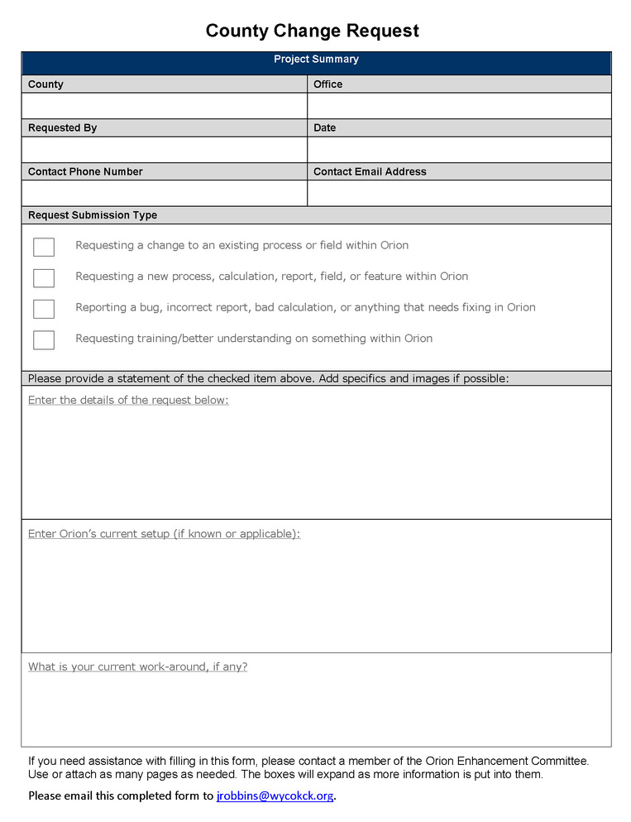
County Change Request
Designed to streamline requests and gather pertinent information to the request being made
Helpful information to include on the form:
Type of request being made
A detailed description of request
What is Orion’s current setup (why the change is needed)
What is your current work around
Screenshots are incredibly helpful as well
2024 ORION USERS CONFERENCE

Slide 4
Enhancement Funds
With the funds available...
Available Funds
$157,644.53
Where would the counties like the committee focus over the next year:
2024 ORION USERS CONFERENCE

Slide 5
Some 2024 Orion
Updates
A Building Link field has been added to the OthImpt Item Page.
Primary Image token in Forms & Docs
Added the Total Units and Total Unit Types on Property Page
New MVP Commercial multipliers to the Cost Valuation Report
Corrected an issue with the Other Building Improvements section displaying incorrectly on the Expanded Appraisal Card.
Land to Building Ratio field at Prop Level
GRM Override fields added
Corrected multiple issues with Spatial.
Corrected an issue for Appraisal Cards incorrectly printing Ag use sections.
CDU Reason Code and Description print on the Appraisal Cards.
Remodel Year and Degree print on Appraisal Cards.
2024 ORION USERS CONFERENCE

Slide 6
2024 ORION USERS CONFERENCE
Orion General Requests
Ability to save default settings like on Documents tab Show XX results
01.
Ability to save default settings like on Documents tab Show XX results
Add additional document sorting options?
Q
Adding a photo gallery view instead of having only a single image view – if printable, how would that work?
Group or Sort Forms/Docs by Mailing Address - ListManager
Q
Add Land Model to Select Properties query in List Manager – Hold issues with pulling parameters from App tab
Party record with 2 mailing addresses: unable to delete one since the Delete option was not active - remove add field and use two party records to track
System-Wide Property Flag behavior could be added to the Party Record Flags. Flags follow the owner record.
Add Recorded Date to the Transfer display grid – in Orion, need to test

Slide 7
2024 ORION USERS CONFERENCE
Orion General Requests Cont
Display phone number and email from the Party Record on Summary tab – discussing layout
Item page Copy and Paste function in the CAMA Tree – working on it
Add List Price field in Transfer – add to the custom section by PVD/County
Add additional fields to the History tab

Slide 8
Appeal Requests
Appeal Packet Value Indication Displaying Income Value can be misleading – all the rules for this setup need to be changed.
Comp Sales Map Display with print option – limited changes at this time
Add selectable Hearing Location for Inf lvl appeals – use alternate option
Attach forms during Group Appeals like print appointment letters
2024 ORION USERS CONFERENCE

Slide 9
Appraisal Tab Requests
Add non-conforming Bed field under Information for Comp Sales on the ResBldg line and on PRC – needs further discussion
Add a data entry view for the components of the Dwelling / Commercial Bldgs – Ag grid still has issues which needs to be fixed first. Possibly add a keyboard cmnd to add page
Add commercial basement adjustments like Physical, Functional, and Override % GD
Ability to “link” Other Improvements together if it’s part of one structure – adding to PRC
Q
2024 ORION USERS CONFERENCE

Slide 10
2024 ORION USERS CONFERENCE
Permits Requests
The report displays the “Comment” field, not the “Description” field, while the import only has “Description” – pull all Permit Information fields into Import
Q
Permits - anyone having sorting issues?

Slide 11
2024 ORION USERS CONFERENCE
CRS/Query Tool Requests
Appeal Extract Query Tool does not include the changed value so we can not get the % change from that Extract – Has been added to the Query Tool

Slide 12
2024 ORION USERS CONFERENCE
Final Review Program Requests
Launch Orion reports from within the Final Review program – adding a button to print same reports as in Property Heading
Need to modify the FinVal grid to display Adj.....ect, Batch reporting based upon accepted values, % field, Rounding: Weighted tenth – will be working on

Slide 13
2024 ORION USERS CONFERENCE
Income Requests
The unit count on the 'Summary Page' of the Income Report does not correctly show the total number of apartments of each bedroom type
Current Income Report layout is difficult to read and explain.
Income Report should show totals (SF, PGI, EGI, EXP, NOI) for each use group at 'end' of report, including a grand total.
Parcels that have "an Age Adj/Pct less than 100% displays no Exp/SqFt value
''Misc Bldg' value, since it is being added to the 'Income Value' should display on the 'Summary Page' of the Income Report
The 'Age Adj Pct' does not calculate or display correctly

Slide 14
2024 ORION USERS CONFERENCE
Packets, Reports, Forms & Documents Requests
Add Situs Address Single Line to Appeal and Transfer forms – alternate solution with token formatting: no return
Create a token that pulls the sketch image like on the Summary tab into a form
Appeal tokens – saving placement on the form. It is moving during form generation – looking further into, for now table the form
Ability to batch delete old User Documents – use CRS & List Manager, Document Delete
Add additional sort options like Owner ID, Owner Name, Mailing Address when running packets in batch
Appeal Packets: Ability to check all items in the packet? Things you might have scanned in the Virtual folder.
Q
Remove the "Base Cost" line item from the Res cost report – reaching out to M&S for more information – depends on report setup, possibly indent all base cost fields to quickly identify
Generate a NBHD Profile from within Orion

Slide 15
2024 ORION USERS CONFERENCE
Market Modeling Requests
Ability to load previous year's Mkt Model flags to the current year’s models when copying models forward – in Orion & will go over at next conf call
Add comment when flagging a sale in Mkt Modeling. Either have it display to the left after the flag or possibly on hover - add textbox the Sales Extract
.

Slide 16
2024 ORION USERS CONFERENCE
Property Record Card Requests
The CDU Reason code descriptions are not showing on the Expanded PRC under the Bldg Comments section like on the standard Appraisal Card
PRC: Switch the dwelling components with the Bldg’s Other Improvements
PVD added the Total Units and Total Unit Types for 2025 on the Property Page under the Prop Name field. Does this need to be on the PRC?
Ability to print Sales History PRC's (single or batch)
Q
Display the Other Improvement link on the PRC once working in Orion – remove LBCS Struct display on PRC
Ability to display the open permits regardless of date followed by closed permits in date descending order.

Slide 17
Questions
Suggestions
Get in touch:
Janae Robbins
Phone: 913.573.8466
Email: jrobbins@wycokck.org

Slide 18
Other Discussion Topics
01
02
03
New Time Adjustment
Pre & Post alternate breaks
Effective Age
How’s it going? Feedback?
WyCo using Pre80/Post80 and creating 2000s break. Lyon Co also using alternate Pre/Post – keep original variables
Where did we leave off?
04
05
06
CVN Changes
*
*
*
*
*

Slide 19
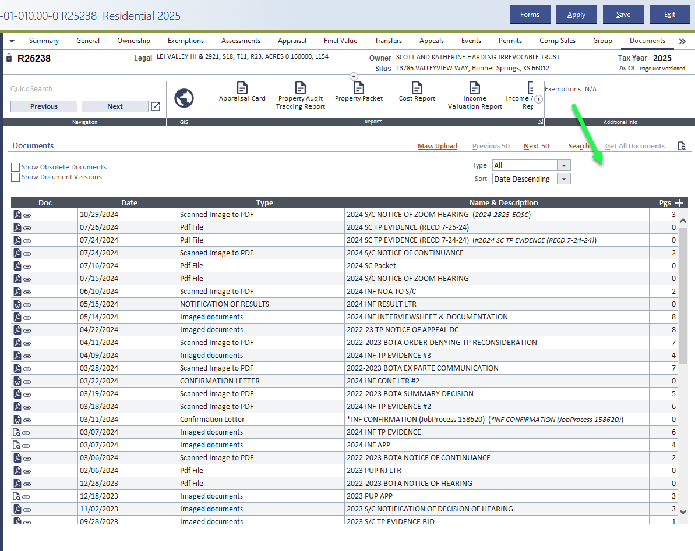

Slide 20
In Orion, have the ability to display/view photos in a gallery view instead of having only a single image view
Can be added to the Summary tab and the Documents tab.
Working on a potential print option. Ideally, how many images would display on one page? Would it be all or nothing?

Slide 21
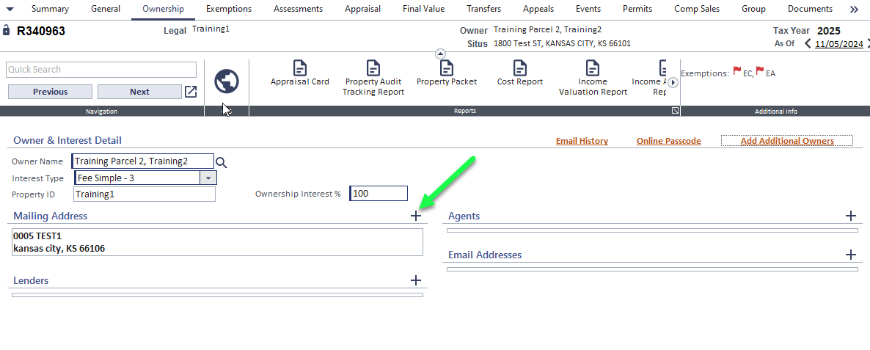

Slide 22
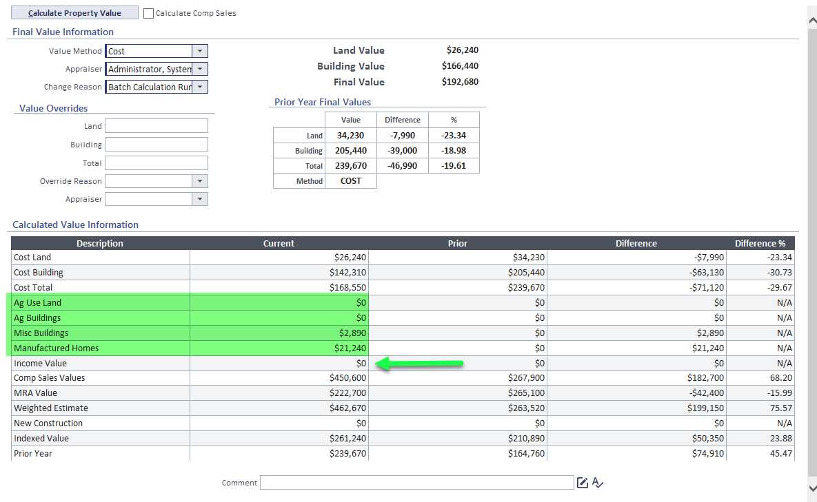

Slide 23
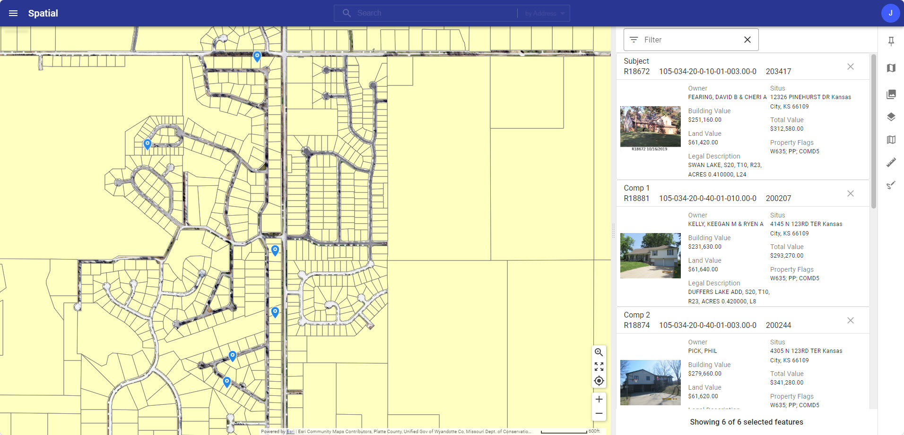
Comparable Sales Map

Slide 24
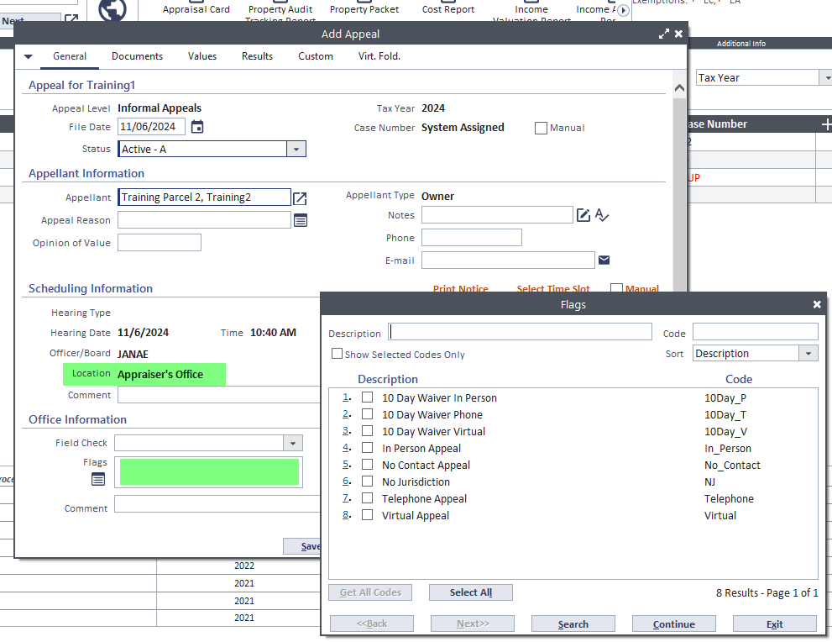
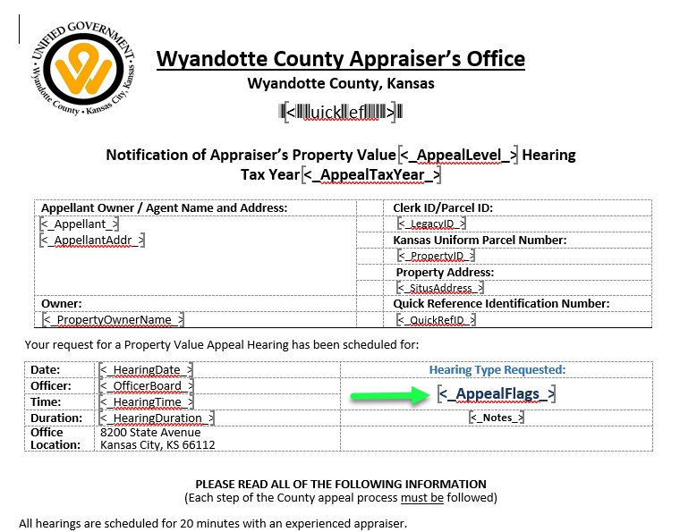

Slide 25
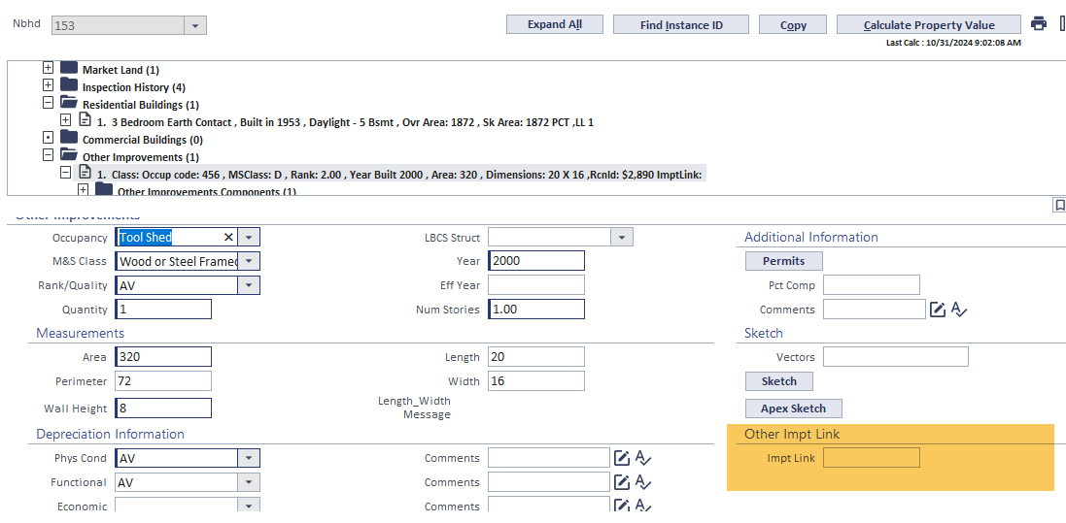
Other Improvement Link

Slide 26
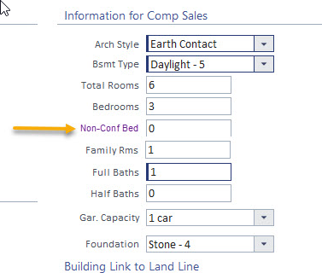
Inconsistent business processes in the way bedrooms are collected amongst counties
How would the work in Market Modeling?

Slide 27
